Slide 1
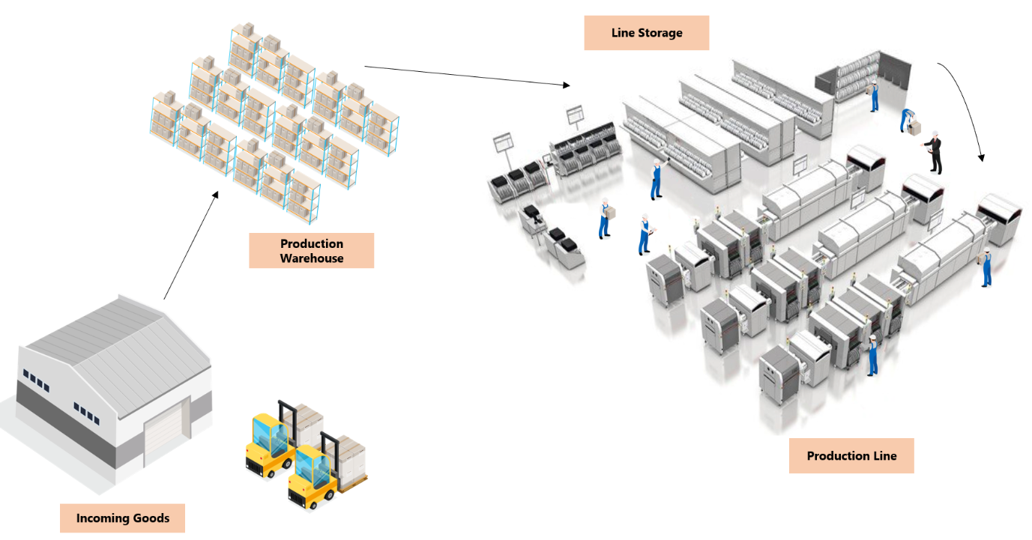
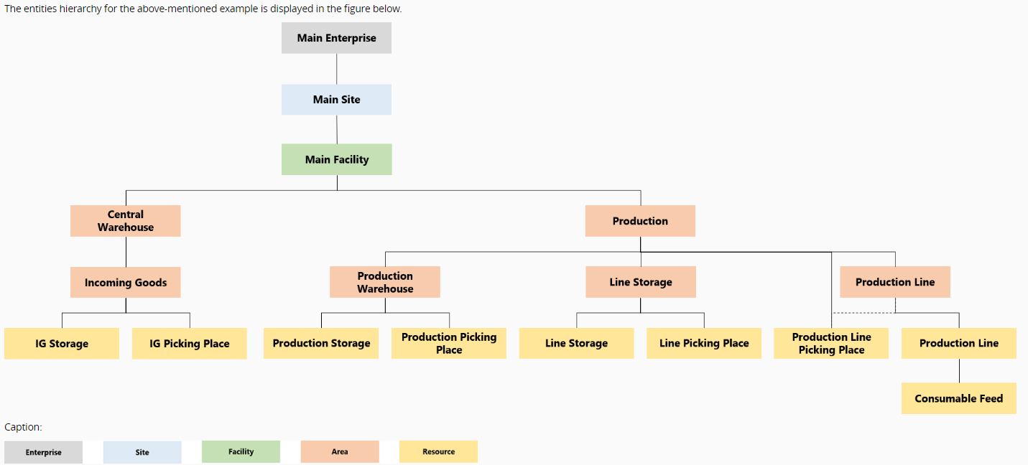

Slide 2
Warehouse
SZ MAG IN SMD (Facility)
Production supply Area
Production Area
S_logisztika Terület / S_logistics area (PSA) for the Facility
Step with Storage services
TRANSFER (managed by Trasnfer requirement types)
Assembly Step (Consumption of BOM items)
CLF (topmost Area)
S_Logistics Picking place
(Processing type: Storage)
Source step for the BOM items
S_logisztika Tároló Terület / S_logistics storage area (sub area type – storage)
S_CLF_Alapanyagok / S_CLF_Raw materials (main Area for CLF Raw materials)
S_CLF_RawM Materials Picking Place
Storage services
Storage services
Feeder services
Assembly 1
Storage resource 1
(Processing type: Storage)
Storage resource 2
(Processing type: Storage)
S_CLF_MonAlapanyagTaroloTerulet/ S_CLF_Assembly raw mat. storage are (sub-are for specific Step’s raw materials)
S_CLF__HevederTarolo_01
Feeder services
Assembly 2
Storage resource n
(Processing type: Storage)
S_CLF_MonAlapanyagTarolo_01
S_CLF_TekHuzalTaroloTerulet/ S_CLF_Winding raw mat. storage are

Slide 3
Production supply Area
S_logisztika Terület / S_logistics area (PSA) for the Facility
Step with Storage services
S_Logistics Picking place
(Processing type: Storage)
S_logisztika Tároló Terület / S_logistics storage area (sub area type – storage)
Storage services
Storage resource 1
(Processing type: Storage)
Storage resource 2
(Processing type: Storage)
Storage resource n
(Processing type: Storage)

Slide 4
Production Areas
Assembly Step (Consumption of BOM items)
CLF (topmost Area)
Source step for the BOM items
S_CLF_Alapanyagok / S_CLF_Raw materials (main Area for CLF Raw materials)
S_CLF_RawM Materials Picking Place
Storage services
Feeder services
Assembly 1
S_CLF__HevederTarolo_01
S_CLF_MonAlapanyagTaroloTerulet/ S_CLF_Assembly raw mat. storage are (sub-are for specific Step’s raw materials)
Feeder services
Assembly 2
S_CLF_MonAlapanyagTarolo_01
S_CLF_TekHuzalTaroloTerulet/ S_CLF_Winding raw mat. storage are

Slide 5
Create raw material (when recieved at PSA;manually through GUI; Store raw material at PSA) Transfer raw Material (from PSA to Production line)
Create Transfer Requirement -> define items -> Release
Create Trasnfer Order -> select items -> Begin Movement -> Complete Movement - > Confirm+Store at production line
Attach Raw material to Production Resource consumable feeders
Detach raw material from Production Resource consumable feeder
Store raw Material at Production line
Transfer raw Material (from Production line to PSA)
Store raw material (at PSA)
Return Raw Materila to Warehouse (from PSA). SAP movement

Slide 6
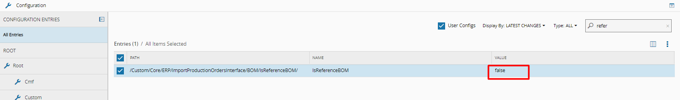
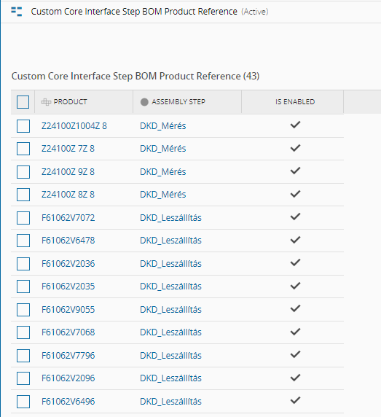
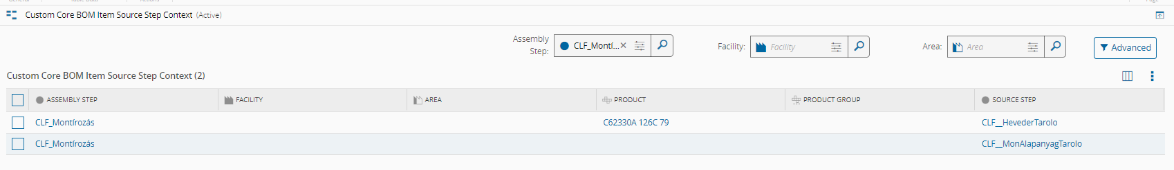
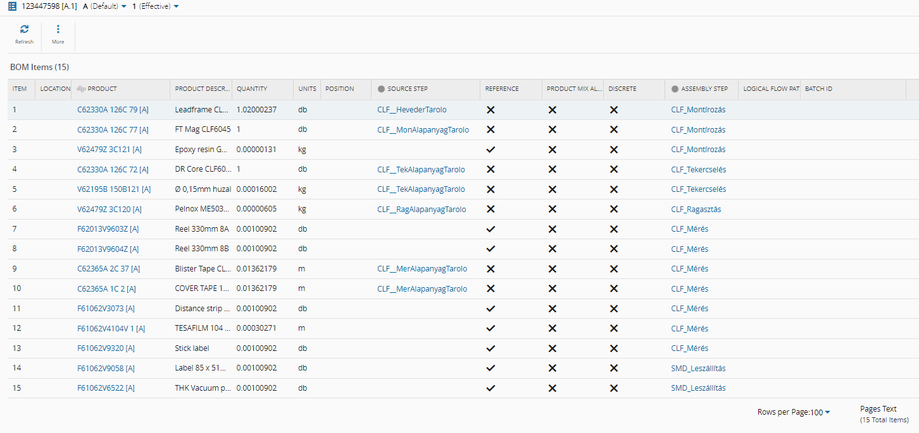
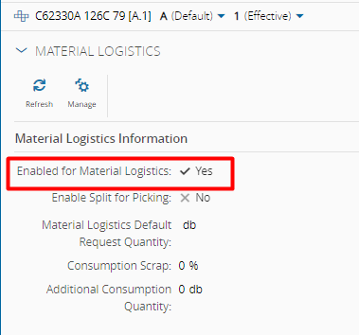
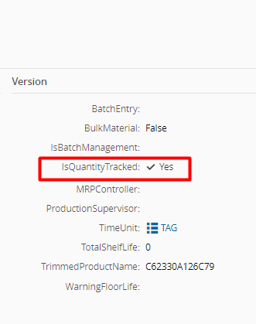

Slide 8
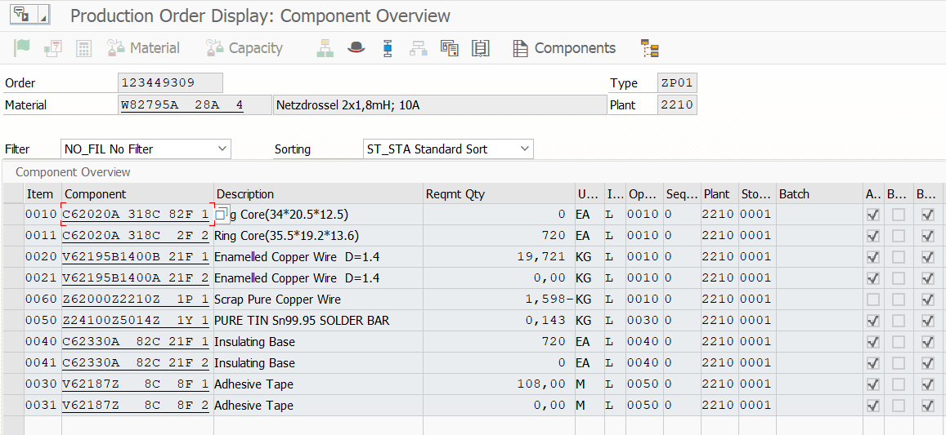
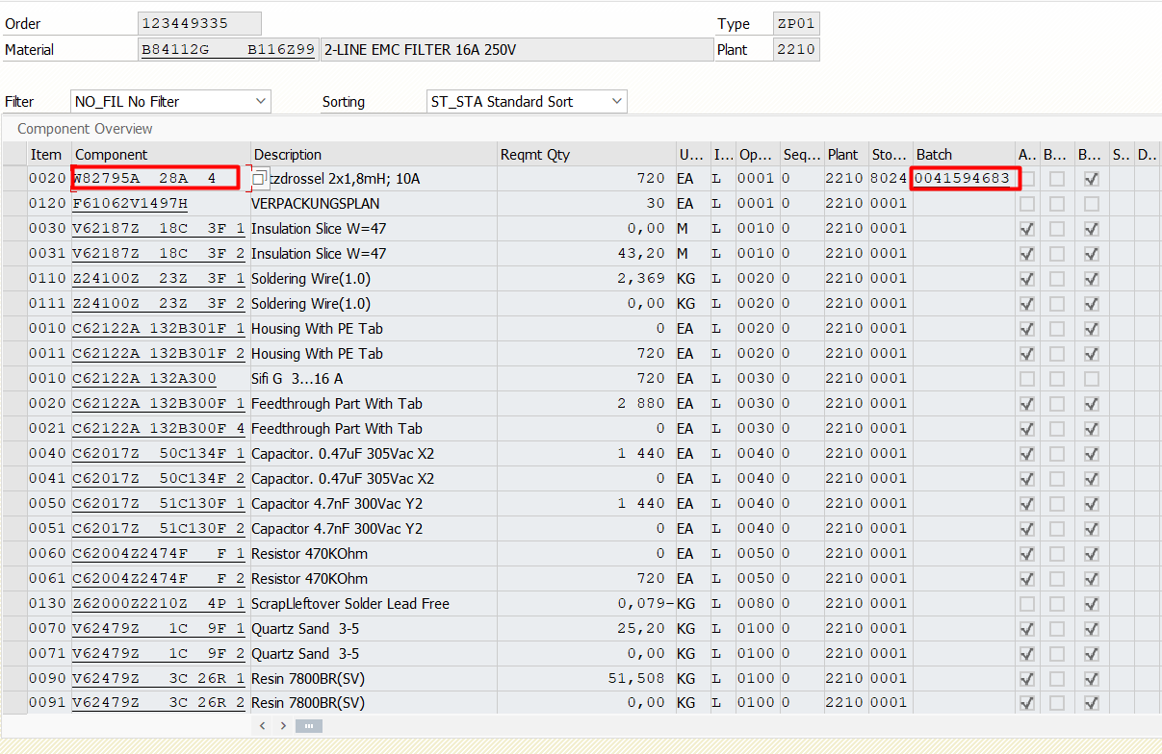
SFG -> FG Order relation handling

Slide 9
SFG -> FG Order relation handling
SFG Order release in SAP
Normal execution in MES untill the last process step of the SAP routing -> PO Status Confirmed.
Move MES Material to an MES only Step (Extension flow). (Materials of the PO to be combined into 1 or n, dependingon the delivery process and number of batches created during SAP delivery)
Deliver Pord. Order in SAP, create Batch ID(s)
Collect Batch ID Attribute for MES Material at the Step of the extension flow.
Question 1 (for the current stage of GoLive): a) The Semi finished good product is planned to be used as a consumable in the Finished good order and validation is needed?
uniqe MES Material ID to be generated and applied as a label for the packaging of the batch, together with the Batch number. b) Or will be Reference item in the MES BOM of the Finished good order?
no need for uniqe MES Material ID
Question 2 :
a) Semi finished good batch remains at the shop floor (PSA)?
Store MES Material in the same (or better in a seperate) Step of the same extension flow – „stock creation”
b) Semi finished good batch is delivered to the warehouse?
Ship MES material for „Warehouse” (MES Facility) – „stock creation” with Terminate on ship setting
In this case the SAP material movement to be done as well seperately.
In case Q1/a option the packaging will contain the uniqe MES Material ID what can be resused/(unterminate?) later, once it returns to the production for usage (should be tested if this kind of Material can be used as a consumable in MES?)
FG Order release in SAP with defined SFG batch in the BOM component
In case Q1/a option: Required model for Consumable management to be defined and created in MES in order to use the SFG batch as a Consumable (Store, Transfer, Attach, Consume, etc.)
In case Q1/b option: as the BOM item is Reference, no action required. Only normal execution of the Order.
there won’t be any linkage in the system between the 2 orders. Short term alternative solutions can be checked

